Slide 1
Submitting Viral Assemblies to GenBank
Bioinformatics Module

Slide 2
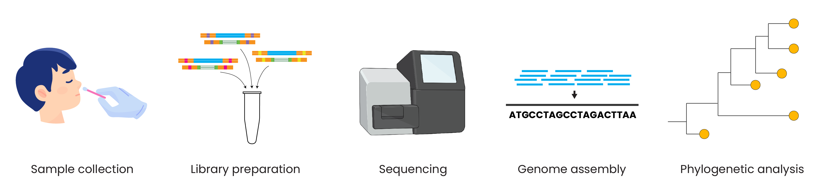
Genomic epidemiology workflow
BioRender.com
Pixel True https://www.pixeltrue.com/about, CC BY-SA 4.0, via Wikimedia Commons

Slide 3
Outline
BioProject, BioSample, GenBank overview
Submission workflow
Metadata format
Common errors and troubleshooting

Slide 4
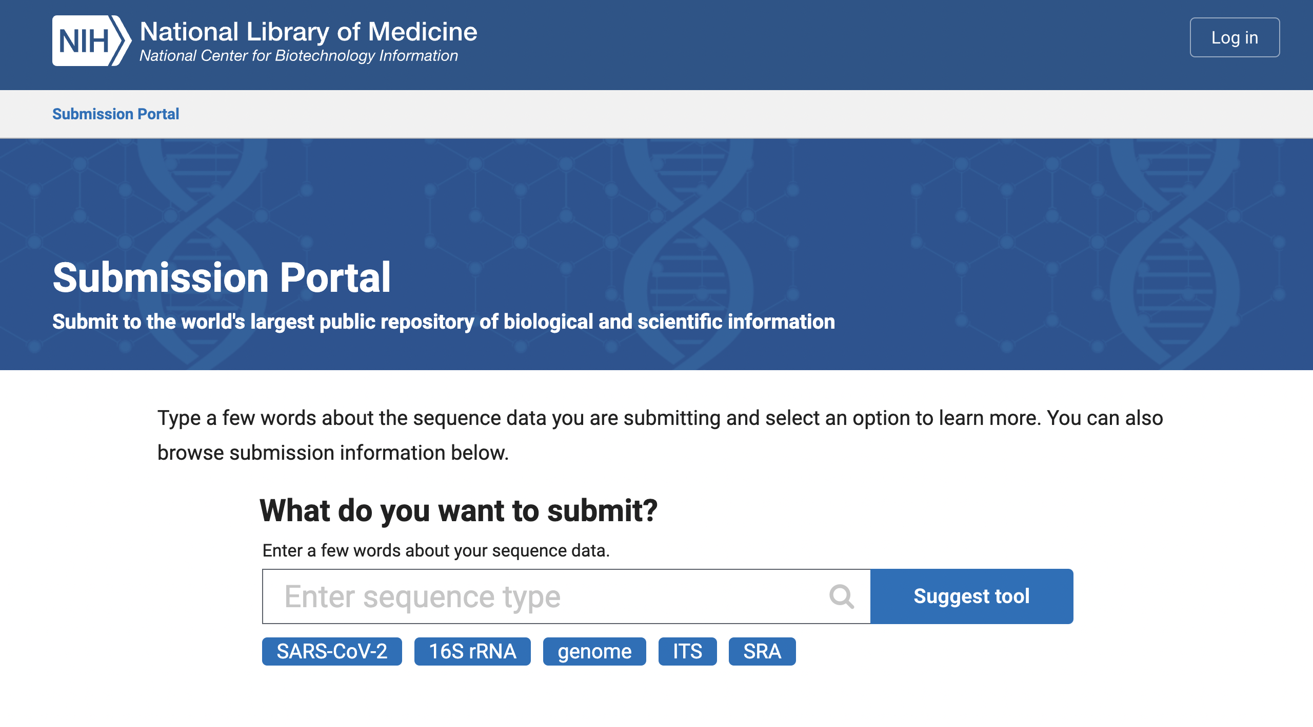
https://submit.ncbi.nlm.nih.gov/subs/genbank/

Slide 5
NCBI data structure overview
BioProject
BioSample
SRA
GenBank
https://www.protocols.io/view/sars-cov-2-ncbi-submission-protocol-sra-biosample-14egn8ydmg5d/v5

Slide 6
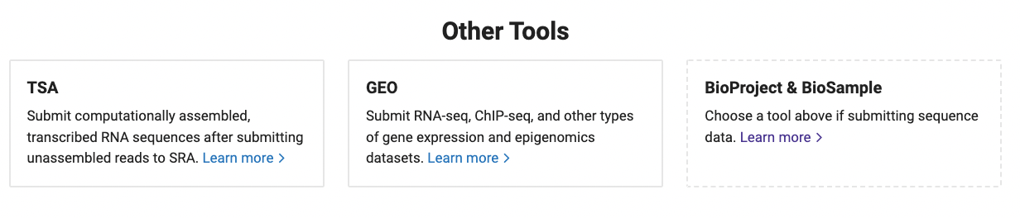
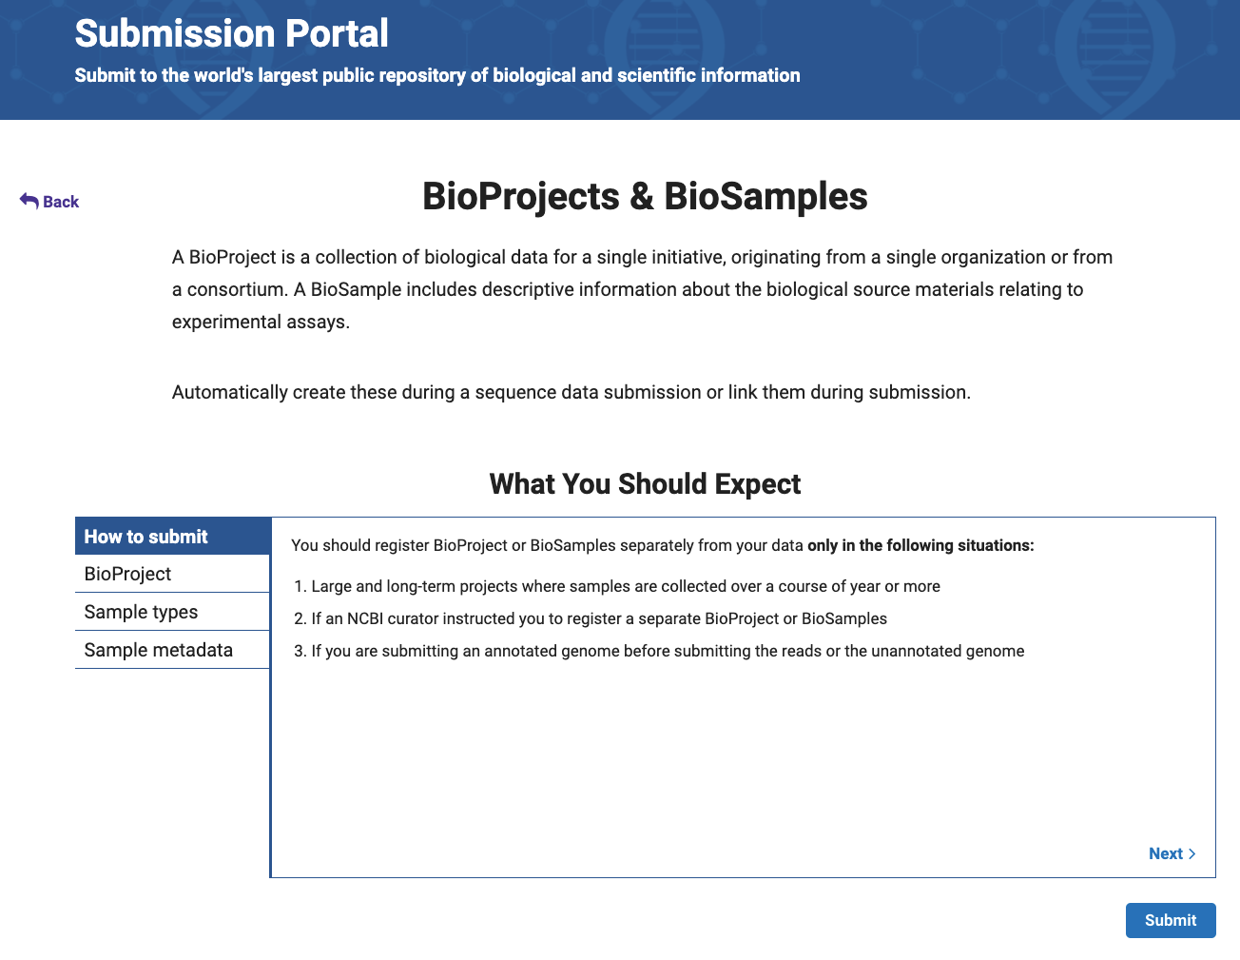

Slide 7
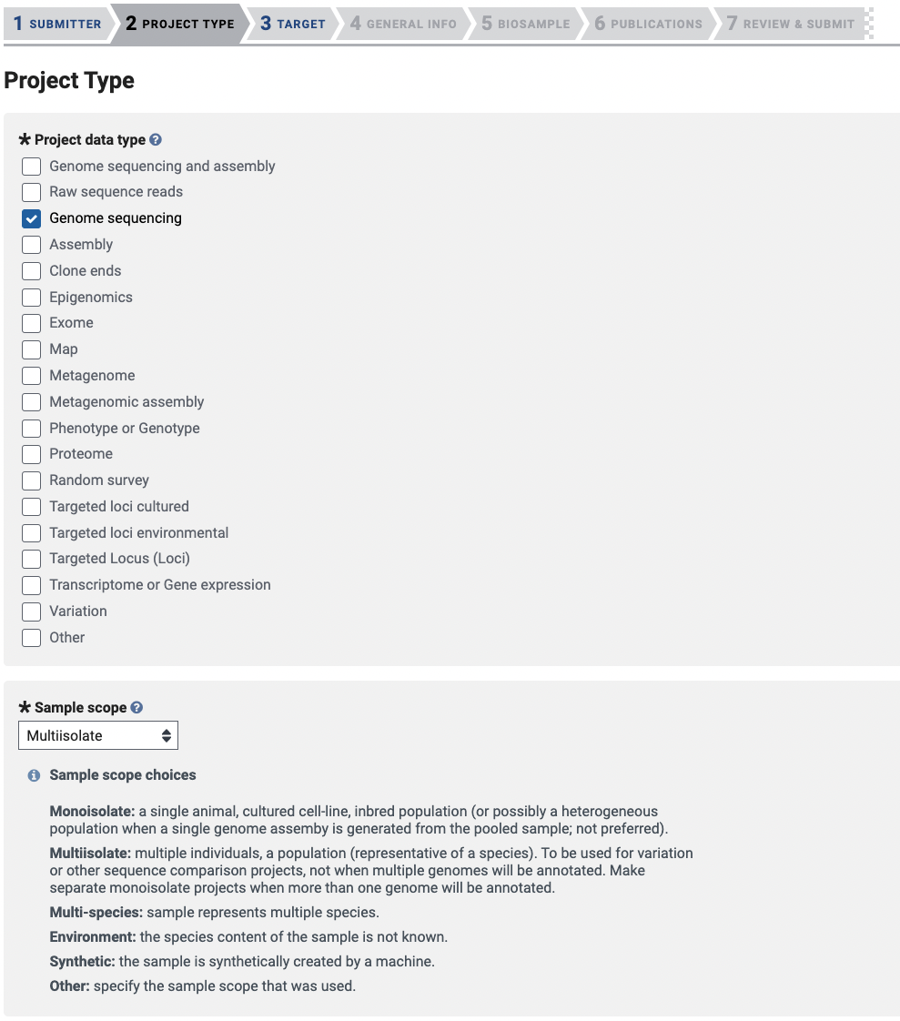
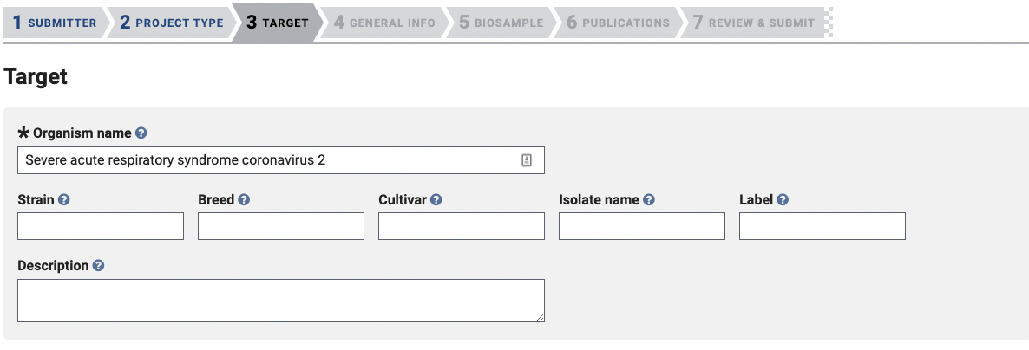

Slide 8
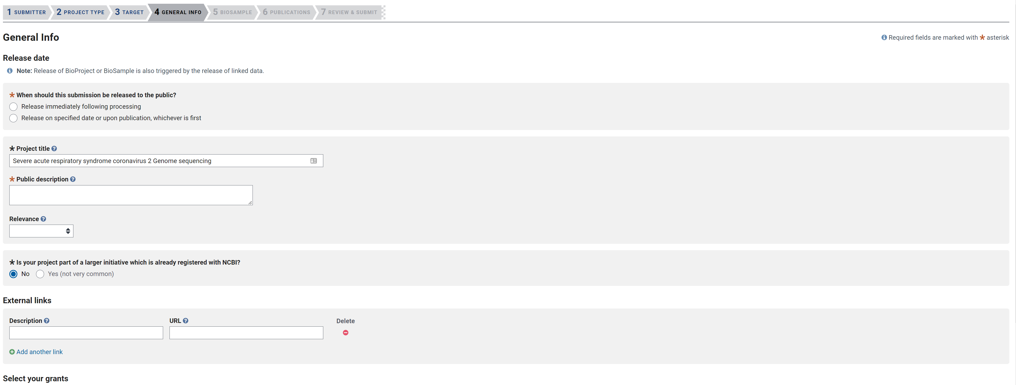

Slide 9
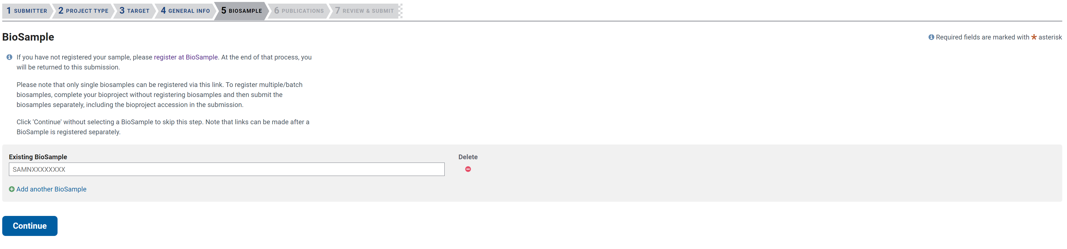

Slide 10
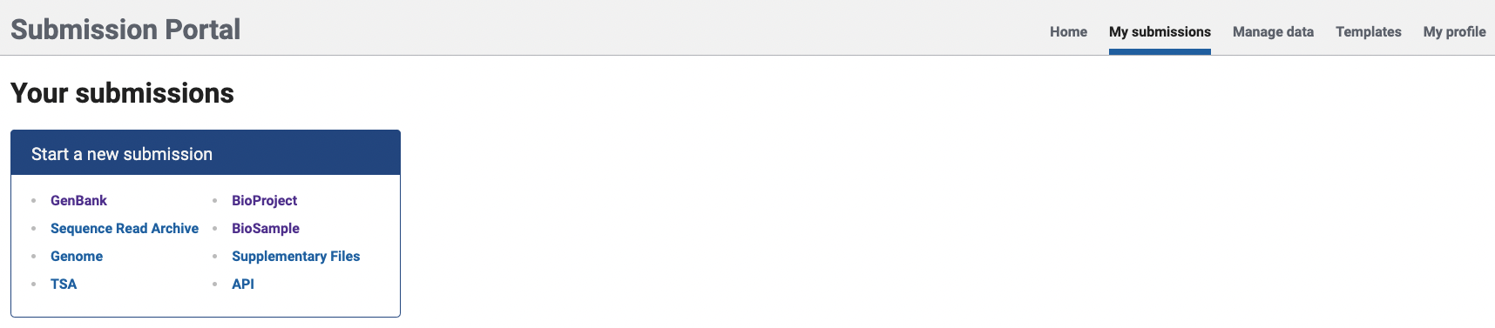
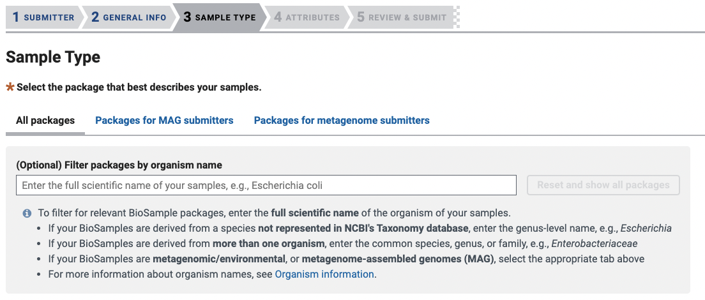

Slide 11
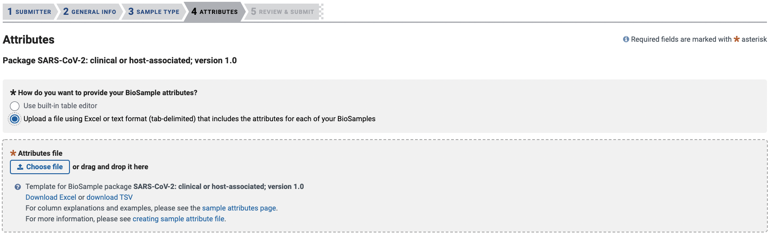

Slide 12
NCBI data structure overview
BioProject
BioSample
SRA
GenBank
https://www.protocols.io/view/sars-cov-2-ncbi-submission-protocol-sra-biosample-14egn8ydmg5d/v5

Slide 13
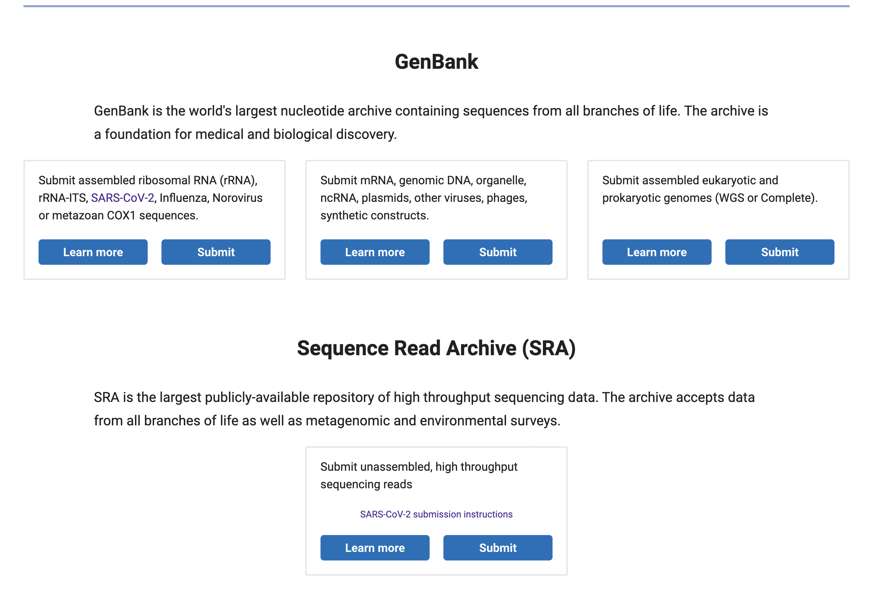

Slide 14
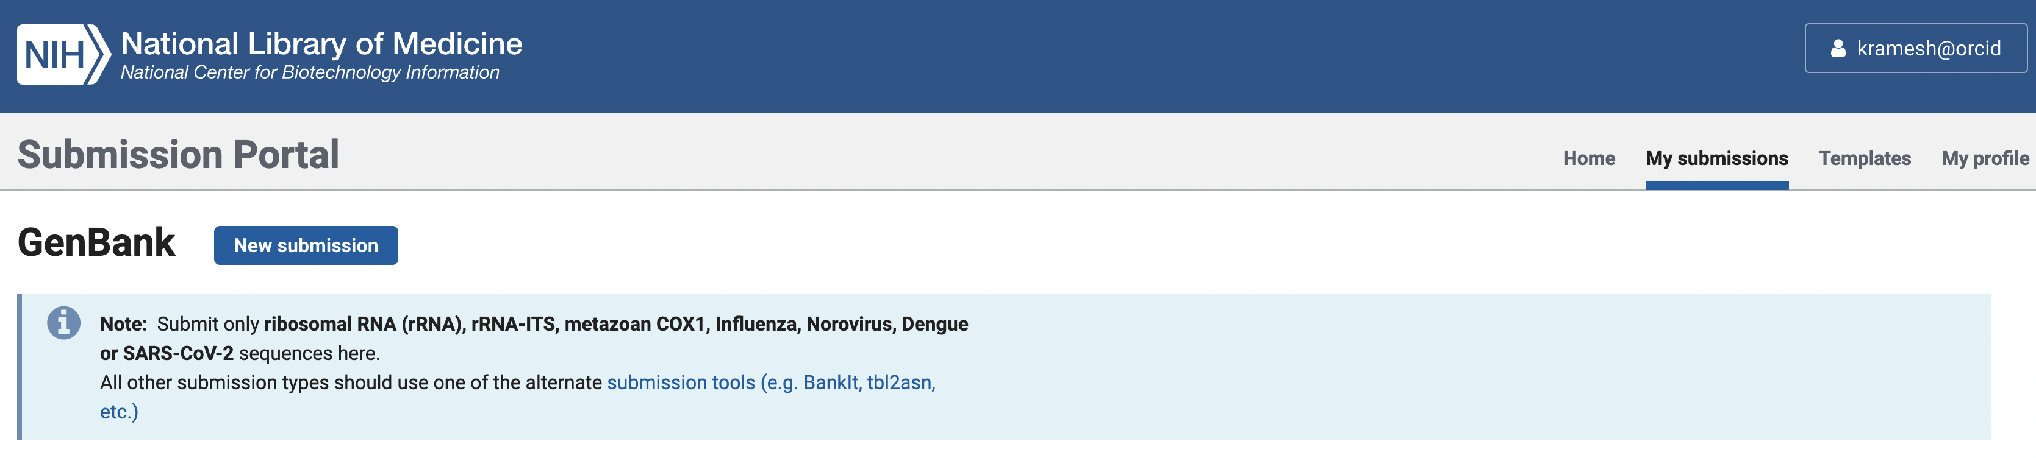

Slide 15
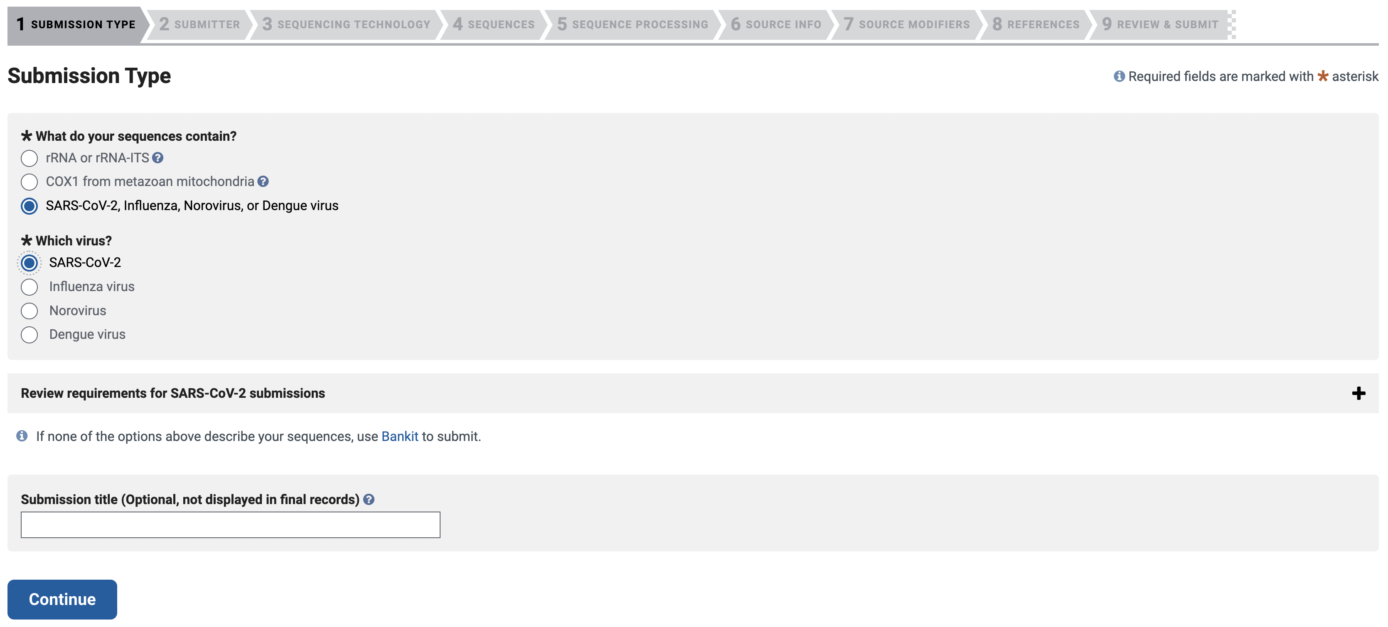

Slide 16
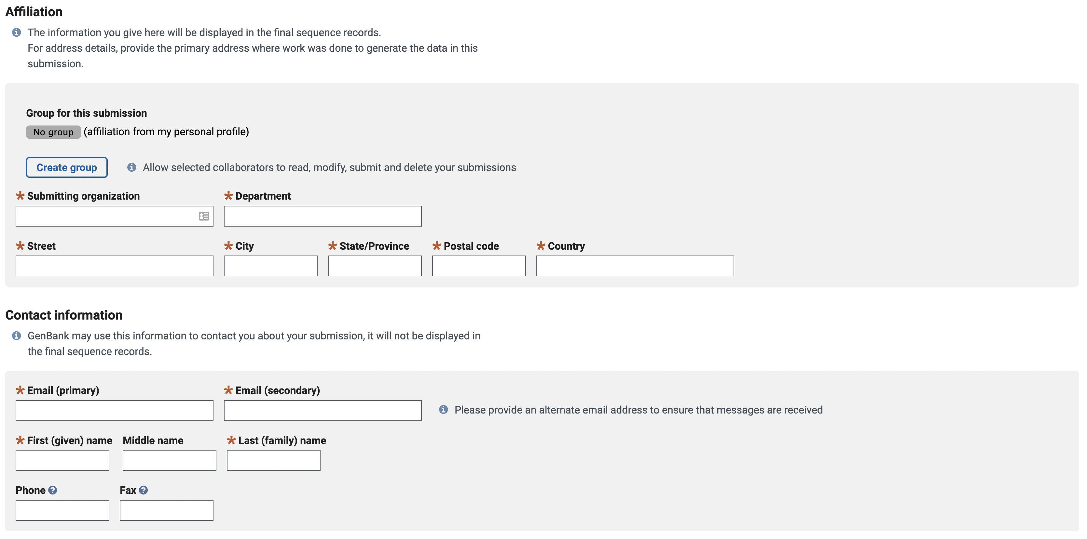

Slide 17
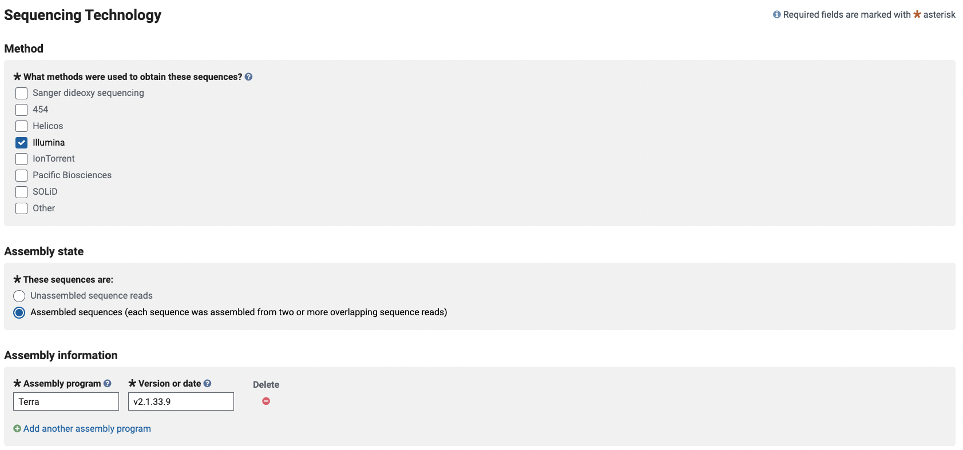

Slide 18
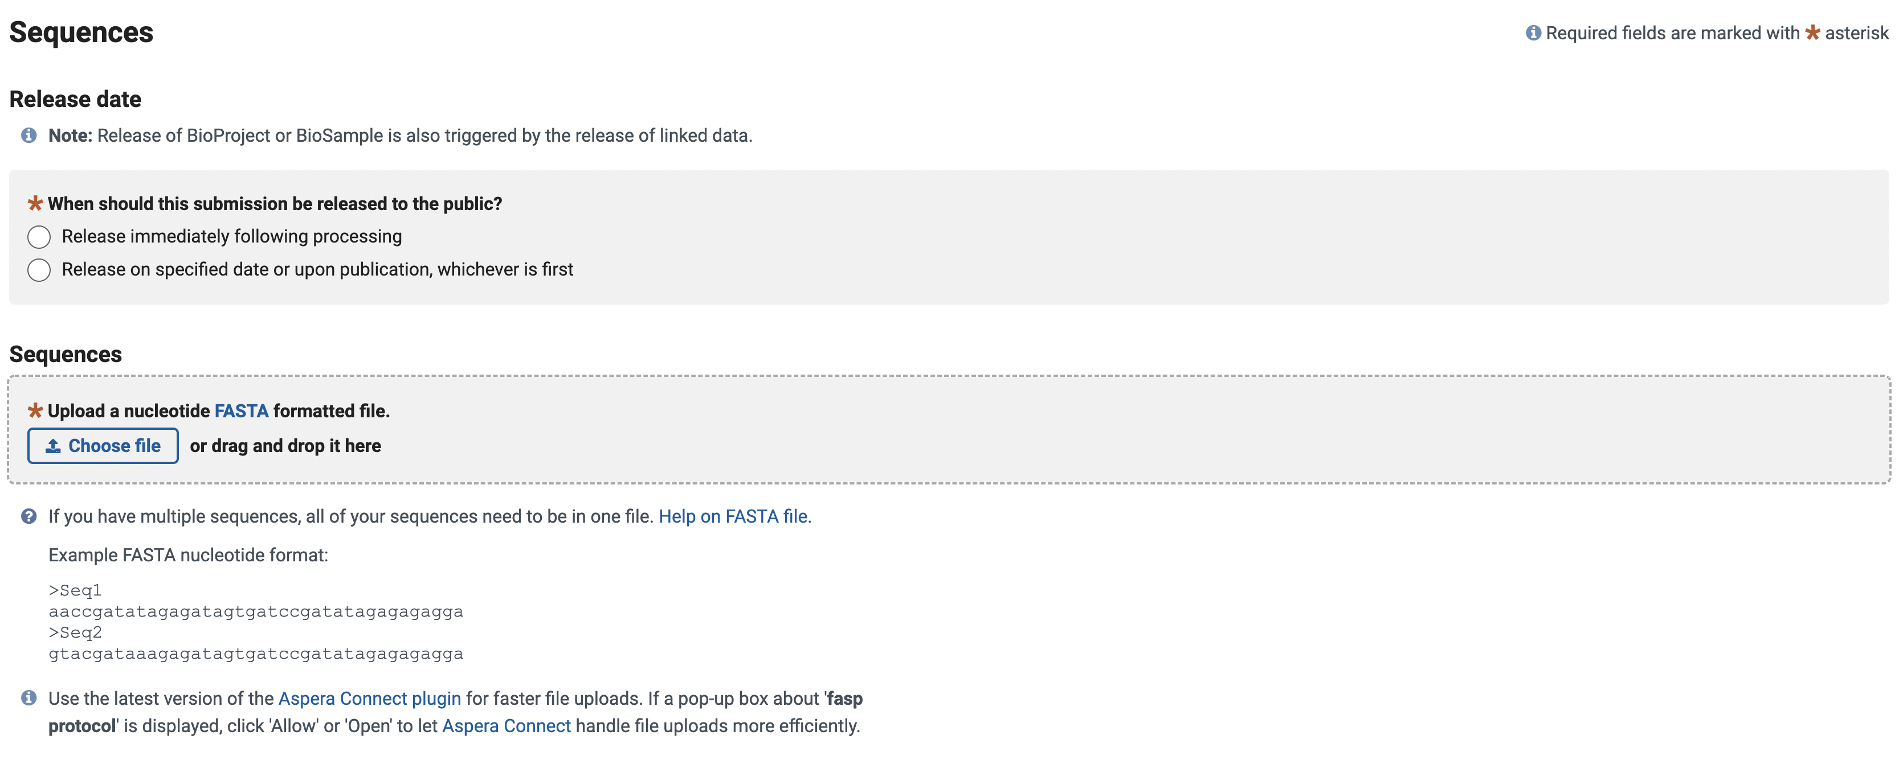

Slide 19
GenBank sequence processing steps
Trim terminal NNNs and ambiguous sequence ends
Remove low quality sequences with >50% ambiguous nucleotides
Check for vector and foreign contamination
Remove sequences below the minimal sequence length
Remove sequences longer than the expected length
Identify and , if needed, remove chimeric sequences
Identify problematic rRNA-ITS sequences. Misassembled, chimeric, or otherwise problematic rRNA-ITS sequences may be removed.

Slide 20
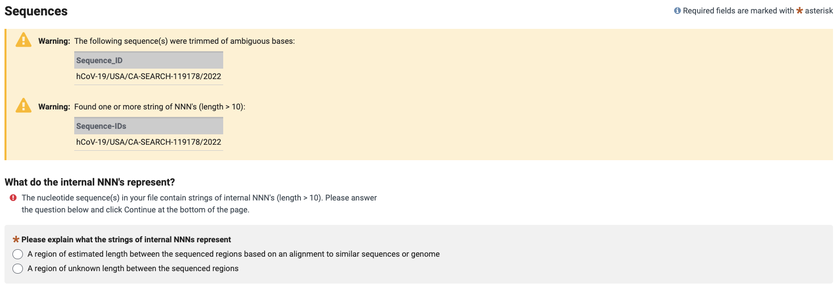
https://submit.ncbi.nlm.nih.gov/genbank/help/#common-information

Slide 21
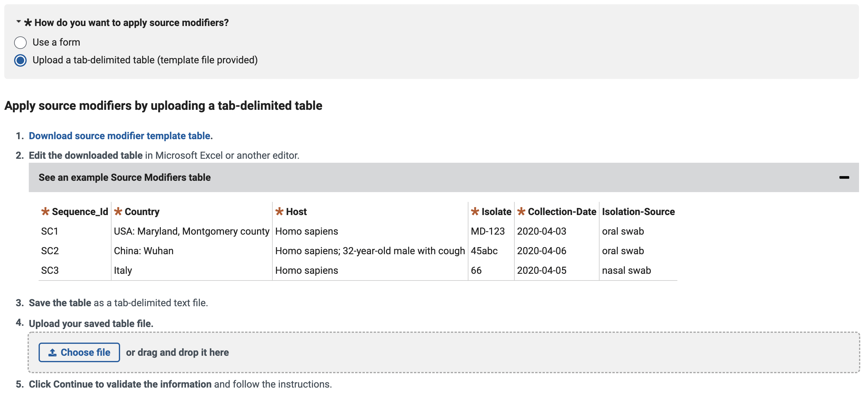
https://www.ncbi.nlm.nih.gov/WebSub/html/help/genbank-source-table.html#modifiers
https://submit.ncbi.nlm.nih.gov/genbank/help/#SARS-CoV-2-sequences

Slide 22
https://www.ncbi.nlm.nih.gov/WebSub/html/help/genbank-source-table.html#modifiers
https://submit.ncbi.nlm.nih.gov/genbank/help/#SARS-CoV-2-sequences

Slide 23
https://www.ncbi.nlm.nih.gov/WebSub/html/help/genbank-source-table.html#modifiers
https://submit.ncbi.nlm.nih.gov/genbank/help/#SARS-CoV-2-sequences

Slide 24
https://www.ncbi.nlm.nih.gov/WebSub/html/help/genbank-source-table.html#modifiers
https://submit.ncbi.nlm.nih.gov/genbank/help/#SARS-CoV-2-sequences

Slide 25
https://www.ncbi.nlm.nih.gov/WebSub/html/help/genbank-source-table.html#modifiers
https://submit.ncbi.nlm.nih.gov/genbank/help/#SARS-CoV-2-sequences

Slide 26
https://www.ncbi.nlm.nih.gov/WebSub/html/help/genbank-source-table.html#modifiers
https://submit.ncbi.nlm.nih.gov/genbank/help/#SARS-CoV-2-sequences

Slide 27

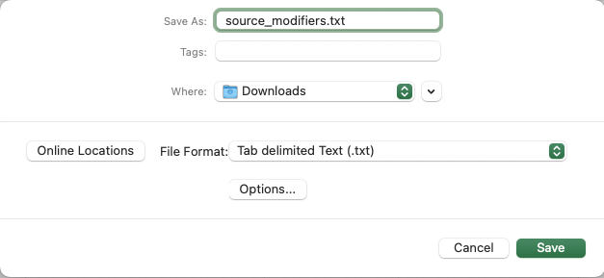
Example Metadata table in Excel

Slide 28
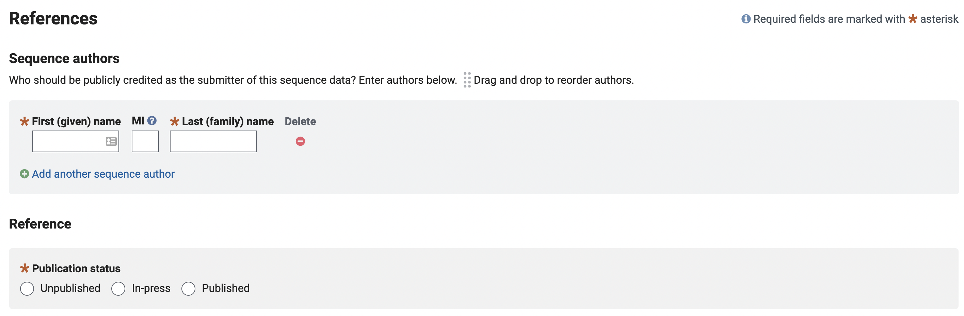
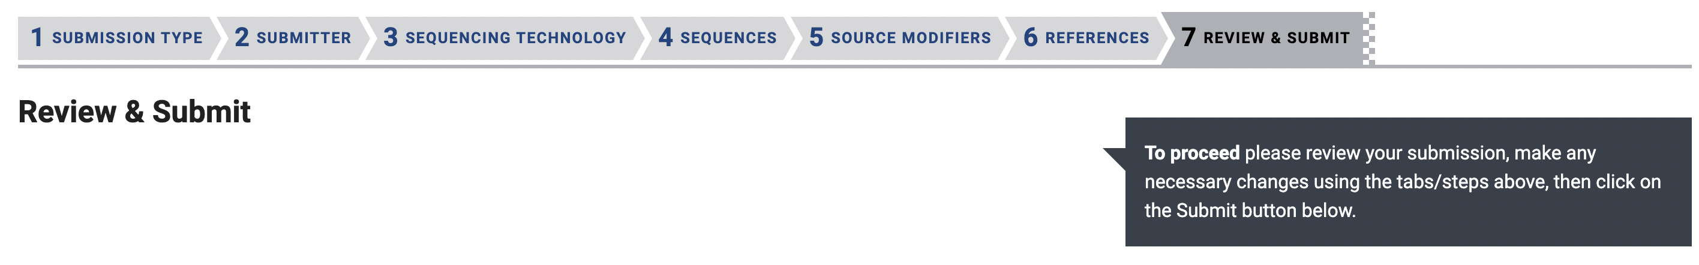
https://submit.ncbi.nlm.nih.gov/genbank/help/#faq

Slide 29
Summary
GenBank is a key repository for many kinds of genomes and interfaces with BioProject, BioSample, and SRA to allow complete data submissions
Batch upload using the online form and tsv template are the most often used methods for submitting sequences
GenBank provides data standards for metadata submission, which must be strictly followed
Errors in GenBank sequence submission can be corrected with curation staff over email

